Slide 1
High-Fidelity, Frequency-Flexible Two-Qubit Fluxonium Gates with a Transmon Coupler, Ding2023
Amalie Paulsen

Slide 2
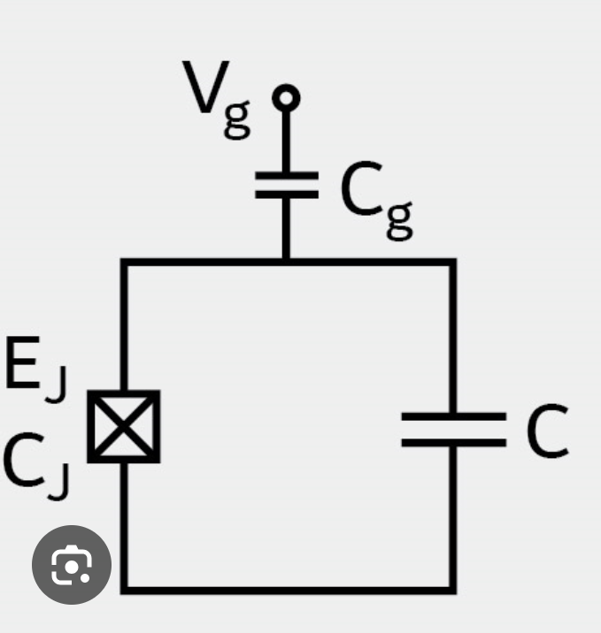
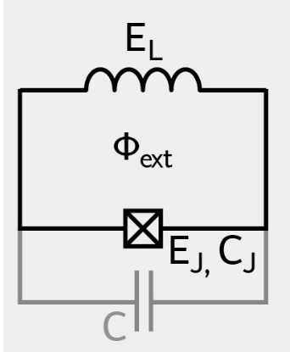
Up to now
Many studies have been done with the Transmon
Have a large transition frequency (around~5GHz)
Weak anharmonicity (~200MHz)
Fluxonium
Larger anharmonicity
Transition frequency between 100 MHz and 1 GHz
Have already achieved single-qubit gate fidelities above 99.99%
Now we want to do 2 qubit gates.
Notes:
Good things about the transmons:
Large coherence times
Easy to design fairly
= 1 ms decoherence
The weak anharmonicity makes fast gate difficult.
The high transition frequency of transmon qubits makes them sensitive to noise and especially to dielectric loss. Affect the qubit coherence. – restricted to nearest neighbohr coupling which makes it difficult to scale.
In transmon qubits, you have a tradeoff between the strength of the 2 qubit coupling and cross-talk as well as decoherence time. Because if you couple 2 qubits very strongly, they also have a tendency to couple a lot to the enviroment.

Slide 3
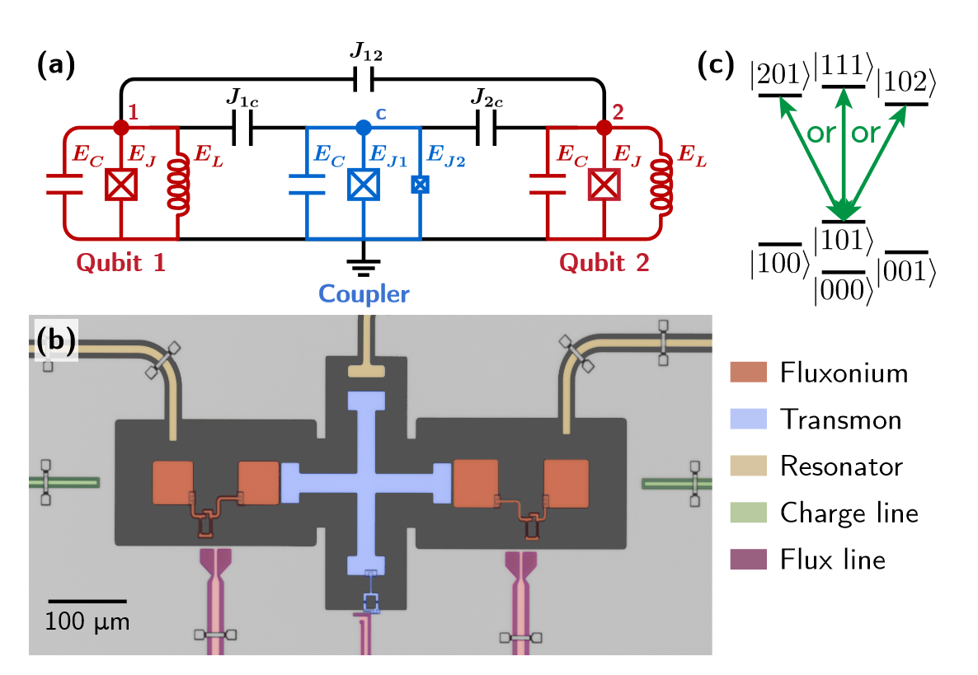
Short summery of article
FTF architecture (fluxonium – transmon – fluxonium) architecture.
They use a Transmon coupler which couples to the higher lying states of the Fluxonium qubits.
Strong coupling between the fluxonium qubits without necessarily strong coupling to the enviroment.
Notes:
We observed millisecond fluxonium lifetimes despite couplings to neighboring qubits, resonators, flux lines, and charge lines, all within a 2D-planar architecture.
Strong capacitive couplings which create a manifold of highly hybridized states that mix the first higher transition (|1〉 ↔ |2〉) of both fluxonium qubits with the transmon’s lowest transition (|0〉 ↔ |1〉).

Slide 4
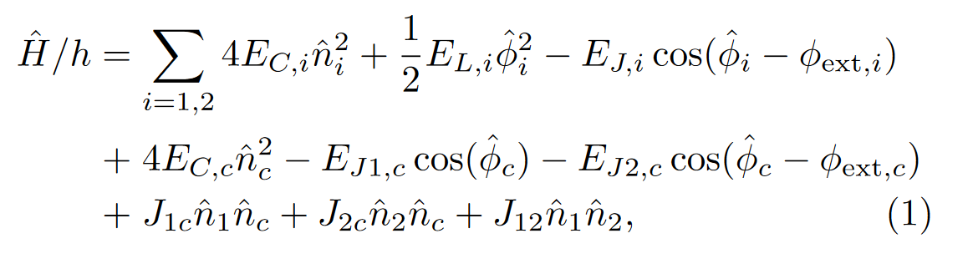
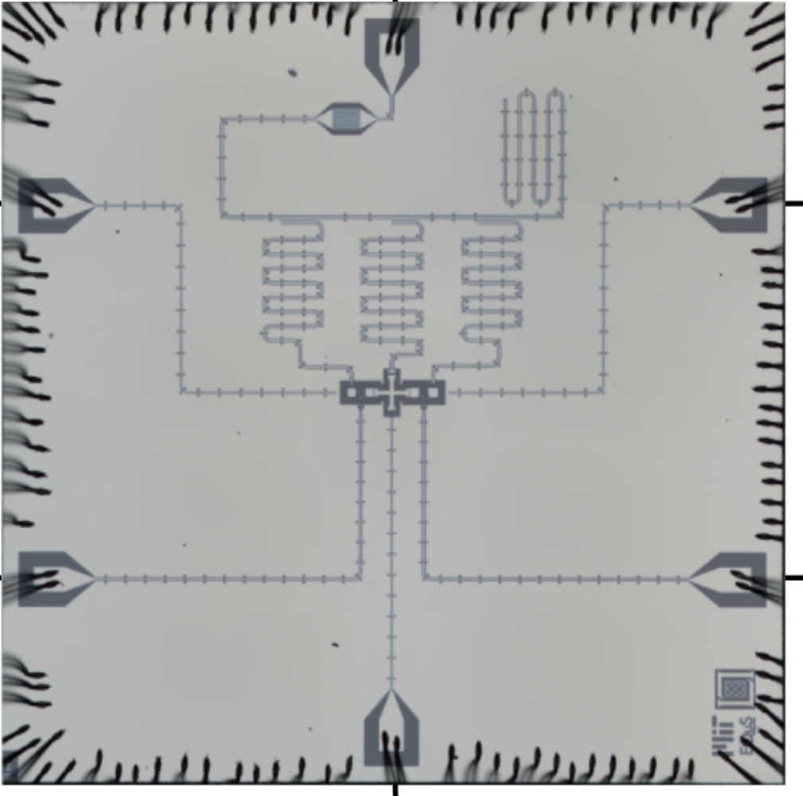
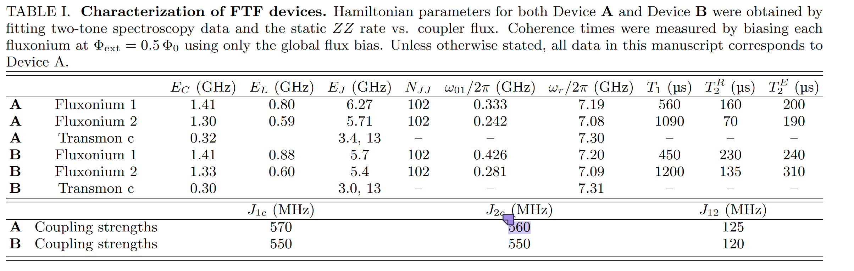
The architecture
Notes:
The two lowest-lying states of each fluxonium form the computational basis {|00〉 , |01〉 , |10〉 , |11〉}, and the first excited state of the coupler, in addition to the second excited states of the fluxonium qubits, serve as useful non-computational states. Modeling only the qubits and their pairwise capacitive couplings, our system Hamiltonian is. The dark grey is Si, the light grey is and yellow is Al (the ground).
Normally you use the tunable coupling to turn on and off the coupling. However in this case, they are always coupled and you use the higher lying states in order to make the 2 qubit gates. You will see that the coupling have a relatively high frequency compared to the fluxonium qubits which means that we can have the coupling turned on all the time without the coupler interacting with the computational states (which is the 2 lowest lying states). Instead the coupler interacts with the higher levels of the qubit. The qubits are always coupled, (you use the higher lying states in order to make the 2 qubit gates). Low frequency.

Slide 5
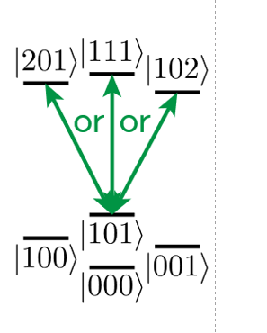
The drawbacks
Crosstalk
Coupling to higher lying states
Large anharmonicity
C_zz
Notes:
Two common drawbacks of larger coupling strengths are remedied using the FTF architecture:
crosstalk due to non-nearest-neighbor couplings, (crosstalk between other states than the computational states because there is a transmon inbetween the fluxonium qubits?
(2) unwanted static ZZ interactions. Arise due to capacitances and inductances. The C_zz can create an unwanted phase or error in computational state.
The origin of the crosstalk: In all transmon-based architectures, the same level repulsion that enables the two-qubit gate also creates level repulsions within the computational subspace. (because they have similar frequencies).
Why we don’t have cross talk:
In FTF, the large ratio of transition matrix elements | 〈2| ˆ n |1〉 |/| 〈1| ˆ n |0〉 | for fluxonium qubits, the large fluxonium anharmonicity, and the large detunings between the transmon and each fluxonium all serve to mitigate these negative side-effects.

Slide 6
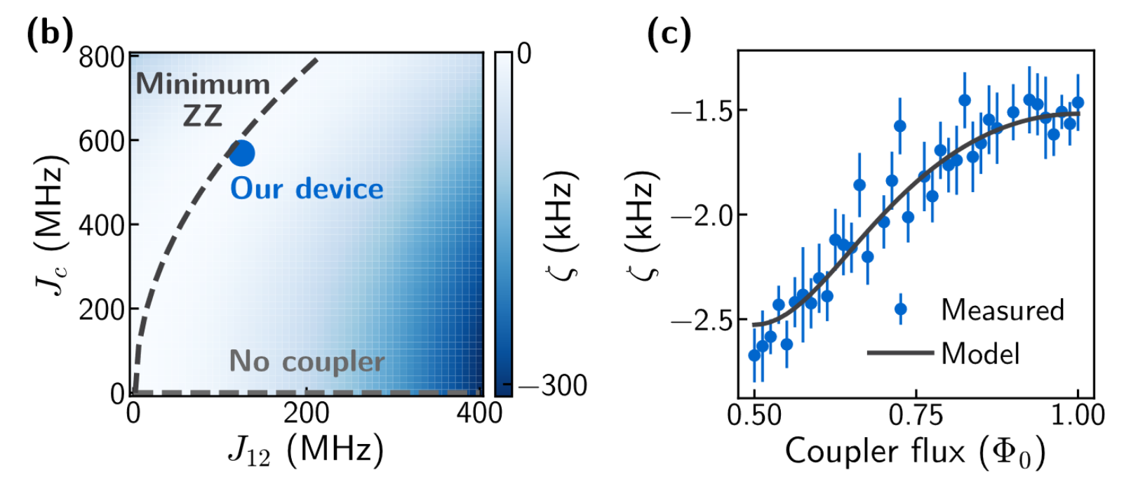

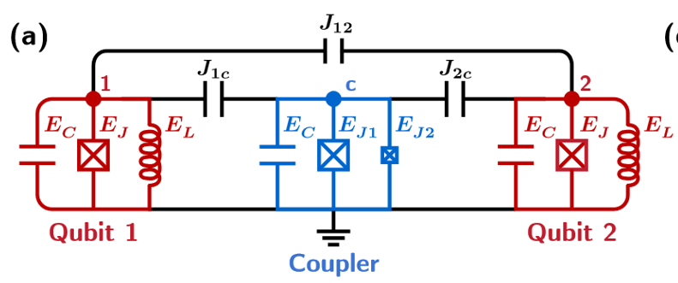
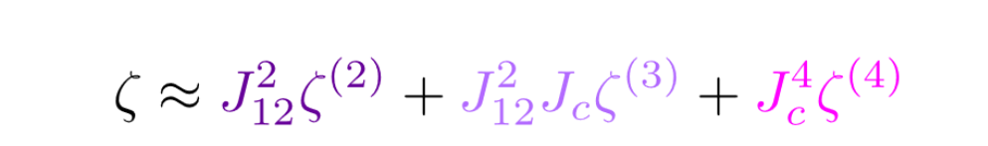

C_zz reduction
|ζ| remains below 10 kHz
Notes:
We still have C_zz . As we learned in SQC, we always have an inductive unwanted C_ZZ inductive and capacitively term but fortunately they are with opposite sign, so we can build them in such a way, so they always will be cancelled. They show both simulation and experimental data.
b)
They simulate the C_zz as a function of the j_c (coupling between coupler and qubit) and J_12 coupling between the 2 qubits).
with the experimentally extracted qubit parameters. (the light region is where the C_z are the lowest).
c) They simulate the C_zz as a function of the coupler flux (You can tune this using the flux line)
Based on this, we can choose our parameters such that the first order correction is zero. t second order, only direct transitions between the two fluxonium qubits contribute to ζ; at third order, the only allowed transitions form three-cycles between the three qubits; and at fourth order, we find that transmon-mediated transitions between the two fluxonium qubits dominantly contribute to ζ.
We see that the 2nd and 4th order terms are negative and the 3rd order term is positive.
Importantly, |ζ| remains below 10 kHz for Jc values of up to 1 GHz, (while we still have a large coupling ration FTF)
ζ is only weakly dependent on Jc, and J12:
ζ is also insensitive to the coupler frequency (to the frequency of the transmon). (this is again due to the fact, that the coupler frequency is far away from the computational states of the Fluxonium qubits.
In other words, any change in the coupler frequency must compete with the large detuning between the coupler and fluxonium |0〉 ↔ |1〉 transitions.
The ZZ rate remains nearly constant between−1.5 and −2.7 kHz

Slide 7
Gate calibration and readout
Notes:
Each qubit is capacitively coupled to a readout resonator – readout using the reflection of the signal.
used a global biasing coil to tune the flux across the entire device and used additional local flux lines biased through coaxial cables for independent control of each qubit.
All three resonators were further coupled to a common Purcell filter
the qubit and readout pulses were played back-to-back with only a short buffer time τ2 to allow for photons to depopulate the readout resonator prior to the qubit pulses. In our experiment, τ2 = 2 μs was much less than the T1 of any qubit, so the qubits do not return to their thermal equilibrium state by the start of the next pulse sequence.
Occasionally there are some single qubit phasedrifts we also have to corrugate for.

Slide 8
Universal gateset
Single qubit Clifford group. For fidelity: A microwave-only gate set,
{I, ±X, ±Y, ±Xπ/2, ±Yπ/2}
Clifford group, resulting in an average of 1.875 gates per Clifford
Generated the two-qubit Clifford group with the gate set:
{I, ±X, ±Y, ±Xπ/2, ±Yπ/2, CZ}
An average of 8.25 single-qubit gates and 1.5 CZ gates per Clifford.
Notes:
It is also these gates they use.
Average of 1.875 gates per Clifford: In order to perform a single Clifford gate operation, on average, it requires 1.875 gates. This means that the implementation of a Clifford gate typically involves applying a sequence of gates rather than a single gate.
For quantifying the fidelities, they performed of these gates, we performed individual as well as simultaneous Clifford randomized benchmarking (RB) using a microwave-only gate set, {I, ±X, ±Y, ±Xπ/2, ±Yπ/2}, to generate the Clifford group, resulting in an average of 1.875 gates per Clifford [12, 38]. Only using microwaves.
I am not sure why – can someone please tell me.

Slide 9
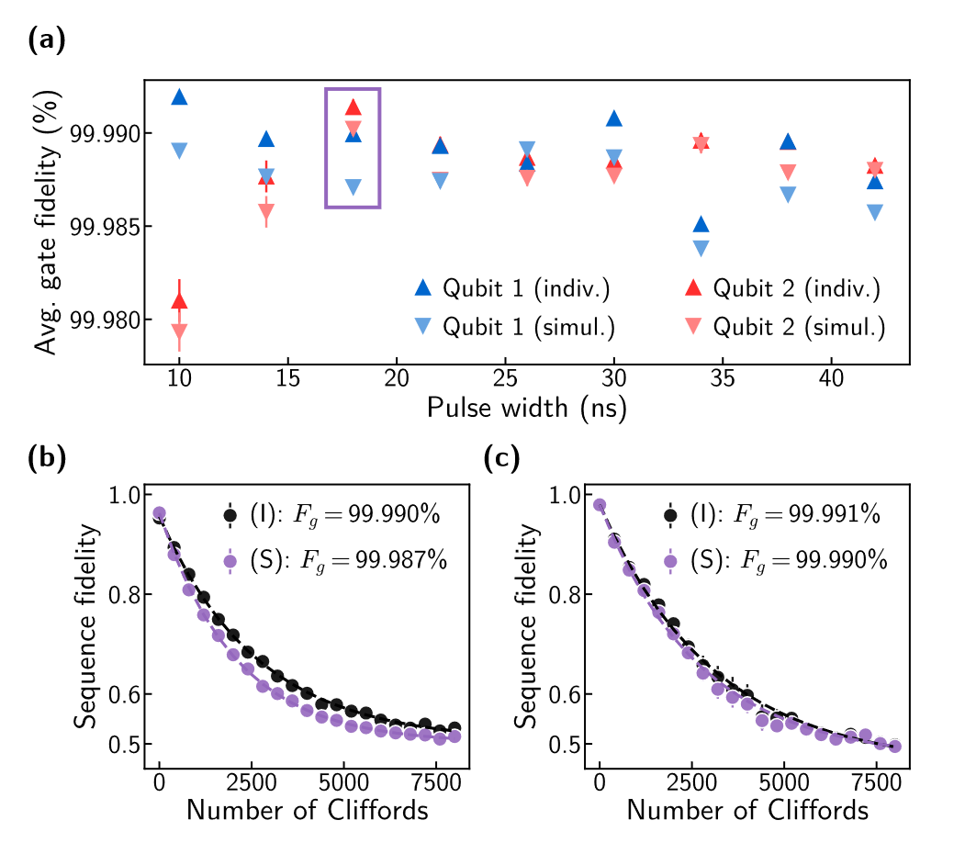
Single qubit gates
Notes:
They varied the pulse width from 10 ns to 42 ns and found average single-qubit gate fidelities consistently near or above 99.99%.
The plot is for gates of 18 ns

Slide 10
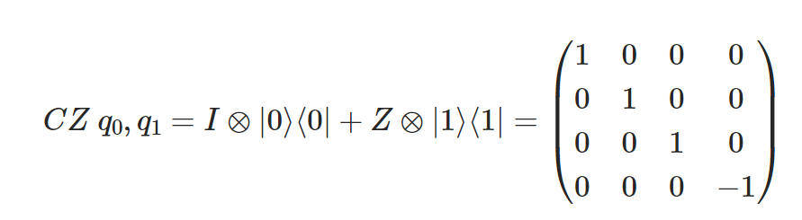
CZ gate
In the computational basis, this gate flips the phase of the target qubit if the control qubit is in the |1⟩ state.
Notes:
microwave pulse from |101〉 to a non-computational state of the joint system. Since we are using the higher laying states, we will also start in the excited state instead of the ground state.
a single-period Rabi oscillation from |101〉 to either |201〉, |111〉, or |102〉 gives the 180◦ conditional phase shift necessary for a CZ gate, provided no other transitions are being driven.

Slide 11
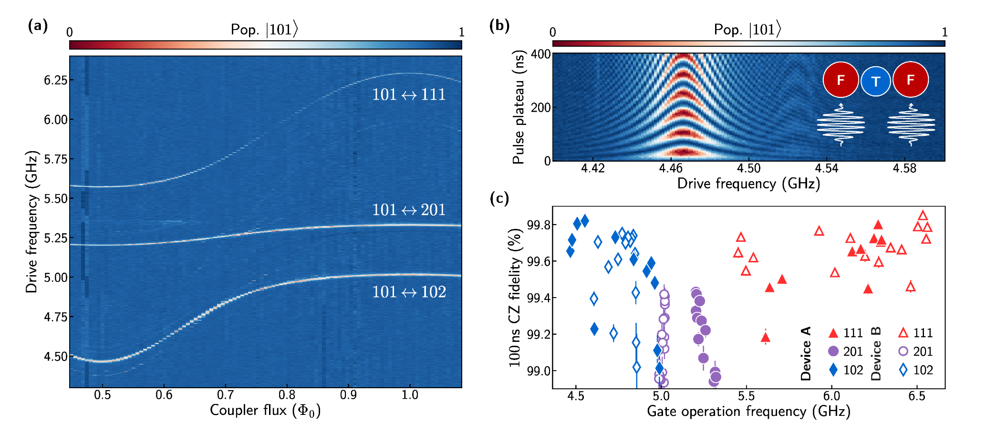
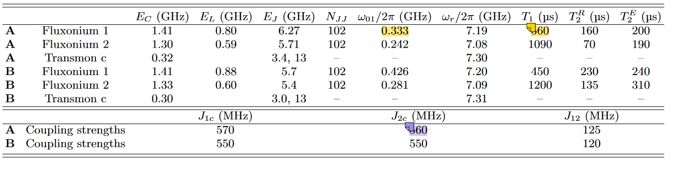
CZ fidelities exceeding 99.85-99.9% range
Notes:
Spectroscopy of relevant non-computational states. The qubits were initialized in the |101〉 state via single-shot readout.
a) First they sweapt the the coupler flux Φext,c to map out the transition frequencies to the three dressed states |201〉, |111〉, and |102〉(21 samples between 0.5 and 1 coupler flux.
We have found that both qubit T1 and T2 (both Ramsey and spin-echo) drop with increasing current. To minimize this effect when performing two-qubit experiments, the global coil was used to simultaneously bias the two fluxonium qubits as close as possible to their operation points Φext,1 = Φext,2 = 0.5 Φ0
(at Φext,c ≈ 0.65 Φ0), with an avoided crossing strength of nearly 1 GHz.
Each data point in Fig. 4(c) represents a fully automated re-calibration of all single- and two-qubit gate parameters without manual fine-tuning. Missing points indicate either failed calibrations or fidelities lower than 98.9%, which may be caused by TLS or nearly resonant unwanted transitions. Neither on device A or B, they could get 2 qubit fidelities to more than 99.8. They made 2 qubit designs, and they were somewhat different in design.
While designed to be nominally identical, the non-computational states in Device B differ by up to 300 MHz from Device A, with no significant detriment to the gate fidelities -> this is again due to that we initialize the 2 qubit gates at another frequency.

Slide 12
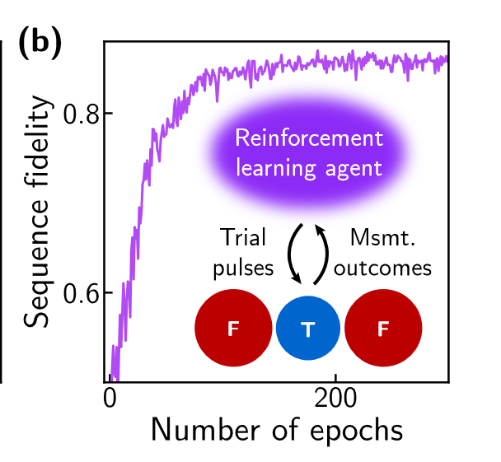
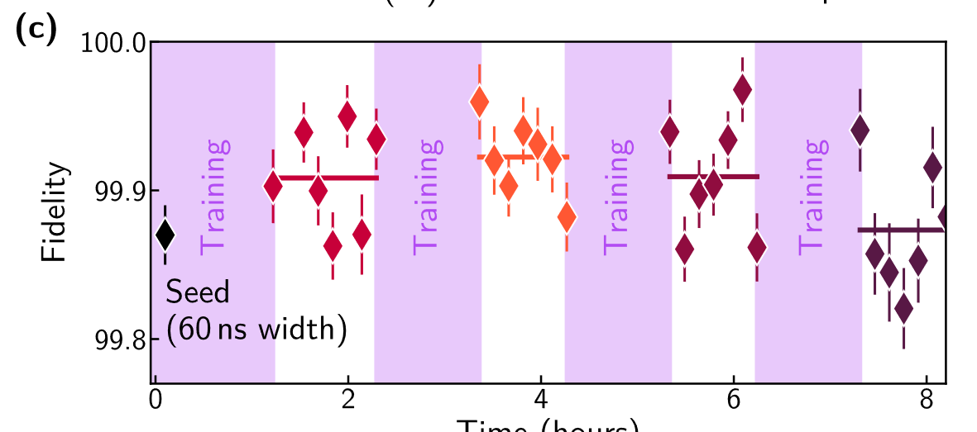
Optimizing the CZ gate fidelity using ML
Notes:
gate fidelity up to 99.922 ± 0.009%, averaged over roughly an hour. To further improve the gate fidelity, we deployed a model-free reinforcement learning agent. we found that it did offer an improvement via fine adjustments of the pulse parameters. Train the agent, we first seeded it with a physicsbased pulse calibration with a pulse width of 60 ns; so they use the reinforcement learning agent in order to optimize the pulse parameters.
the agent was given full control of the I and Q quadratures of the pulse en
[Fig. 5(b)]
Fidelity of an interleaved randomized benchmarking sequence with 28 Cliffords using trial CZ gates sampled from the policy of a model-free reinforcement learning agent. After each epoch, the measurement results were used to update the agent’s policy according to the PPO algorithm.
Then, with a fixed CZ pulse width of 50 ns, the agent was trained to maximize the sequence fidelity of interleaved randomized benchmarking at 28 Cliffords with a fixed random seed by optimizing the pulse shape and virtual-Z gatesTraining was then repeated using the optimized pulse shape from the previous training round as the seed for the next.
[Fig. 5(c)] – after each epoch, the updated the agent (the learning agent). This is 70 total Clifford sequences.
the fidelity peaked after the second round of training

Slide 13
Conclusion
Propose a coupling scheme between 2 fluxonium qubits with a Transmon coupler.
Using non-computational states and avoids cross-talk.
High T_1 despite strong qubit-qubit coupling
Yielded a high fidelity operation across a large frequency-tunable range, reproduced across multiple devices.
capacity for large coupling strengths while simultaneously reducing the ZZ interaction strength to kHz levels.
A fixed-frequency transmon (or simply a resonator) would suffice for this use case
Notes:
Both the single- and two-qubit gates performed here are also simple – operating on the basis of a Rabi oscillation.
the largest contribution to gate infidelity was the coherence of the |201〉, |111〉, |102〉 manifold. Yet, the lifetimes of these states were much lower than expected, given coherence times measured on transmons with similar frequencies.
Meaning if you want to use the higher lying states in order to perform 2 qubit gates, you also need to operate quite fast as the lifetimes of the higher lying states are pretty low.
The new take in this article is really to couple 2 fluxonium qubits via a transmon coupler and use the higher lying states to make the 2 qubit gates.
What about post selection and readout

